Slide 1
Web Search Engine and Security Threat
MR Gouasmia Zakaria
Notes:
Web search engine and security
As we all knew the search engine become very important in our daily life
All of us spend hours surfing in the different web search engine existing today
But we should know that for any technology exist there is some people want to use it in malicious way .
-As my search domain I focused here in the security side of it
What’s the risk and how to protect

Slide 2
outline
Introduction
Problem Statement
Basic Web Search Engine
Web Crawlers
SEO Attacks
Managing the SEO attacks
Notes:
As outline this presentation cover some important titles from my research proposal .
From introduction to web crawlers technique and closing by the SEO attacks and managing the attacks

Slide 3

Introduction
Notes:
Basic introduction
Today The web creates new challenges for information retrieval. The amount of information on the web is growing rapidly, as well as the number of new users inexperienced in the art of web research.
So in addition of the search services the need of protect the users become much more important then years ago .

Slide 4

Problem Statement
Notes:
The problem statement is clear from the title
Basically is that Search engines index a huge number of Web pages and other resources that sometimes inadvertently expose security weaknesses and confidential data.
Hackers can use search engines to make anonymous attacks, find easy victims, and gain relevant knowledge, and in some cases, can be more than enough to make a powerful attack against them and there company .
also, search engines can help hackers avoid identiﬁcation, which is one of a hacker’s main objectives

Slide 5
Basic Web Search Engine
Notes:
A web search engine or Internet search engine is a software system that is designed to carry out web search, which means to search the World Wide Web in a systematic way for particular information specified in a textual web search query.
The search results are generally presented in a line of results, often referred to as search engine results pages. The information may be a mix of links to web pages, images, videos, infographics, articles, research papers, and other types of files

Slide 6
Basic Web Search Engine
The main steps in any search engine are:
Gathering also called “Crawling”
Maintaining Database/Repository
Indexing
Querying
Ranking
Notes:
1- Gathering also called “Crawling” :
This operation is performed by special software; called “Crawlers” Crawlers are small programs that `browse' the Web on the search engine’s .
2-Maintaining Database/Repository:
All the data of the search engine is stored in a database. All the searching is performed through that database and it needs to be updated frequently.
3-Indexing
Once the pages are stored in the repository, the next job of search engine is to make an index of stored data.
4-Querying
This section deals with the user queries. The query engine module is responsible for receiving and filling search requests from users
5-Ranking
Since the user query results in a large number of results, it is the job of the search engine to display the most appropriate results to the user. And here is the most famous attacks for the search engine we will see it next
And basically the hackers use specific technics to compromise the data base

Slide 7
Search-Engine Architectures
We can distinguish three architectures for Web searching
Centralized Architecture
Metasearch Architecture
Distributed Search Architecture
Notes:
And after that We can distinguish three architectures for Web searching

Slide 8
Search-Engine Architectures
Centralized Architecture

Slide 9
Search-Engine Architectures
Metasearch Architecture
Notes:
One way to provide access to the information in the hidden Web’s text databases is through metasearchers, which can be used to query multiple databases simultaneously

Slide 10
Search-Engine Architectures
Distributed Search Architecture

Slide 11
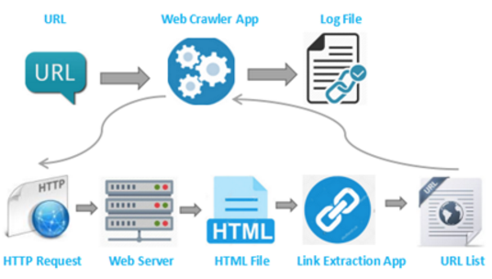
Web Crawlers
Notes:
One of the most essential jobs of any search engine is gathering of web pages, also called, “Crawling”
A Web crawler, is an Internet bot that systematically browses the World Wide Web, typically for the purpose of Web indexing (web spidering). Web search engines and some other sites use Web crawling software to update their web content .
Web crawling(spidering) is not used to hack anything, but to gather information on the target/victim.
Before a website attack or penetration test, they need to spider the site. Many of the tools used to attack a website need a map of the website in order to do their work.
with crawlers they could manually spider it . by simply navigating to each page and saving it, but with crawlers , they build tools that can save time and automate this process for any target .

Slide 12
Web Crawlers
the basic terminology
Seed Page
Frontier (Processing Queue)
Parser

Slide 13
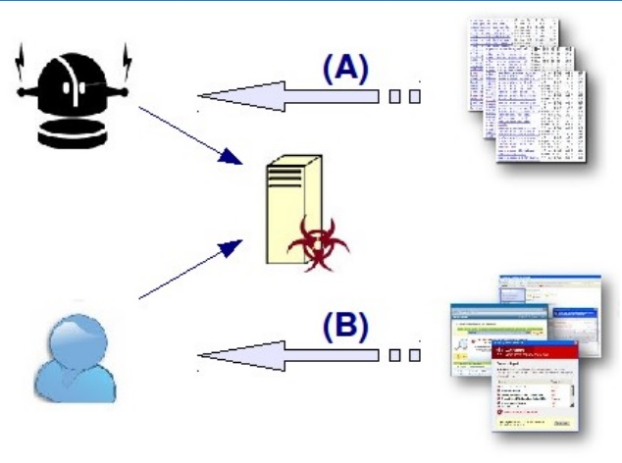
Overview of SEO attacks
Notes:
In concept, SEO driven attacks are pretty simple.
The attackers use SEO kits (PHP scripts typically)
to create web pages stuffed with topical keywords and phrases that will be consumed by search engine crawlers.
Then, when a user searches for such keywords they are presented with a link to the SEO page high up in the search engine results.
Clicking on the link is all it takes for the user to be exposed to malware.
The SEO kit recognises they have arrived via a search engine and redirects them to some malicious websites

Slide 14
Negative SEO
Hacking your website
Building hundreds or thousands of spammy links to your website
Copying your content and distributing it all over the internet
Pointing links to your website using keywords like crime, poker online, and many others
Creating fake social profiles and ruining your reputation online
Removing the best backlinks your website has
Notes:
Historically, black hat SEO is something we might have associated with spammers, scammers and disreputable on­line merchants.
it is being used to drive user traffic to malicious sites for the purposes of distributing malware, particularly fake
anti­virus Trojans (often termed scareware).
Negative SEO refers to the practice of using black hat and unethical techniques to sabotage a competitor’s rankings in search engines. Negative SEO attacks can take a number of different forms:

Slide 15

Negative SEO
Disavow
Notes:
f you conduct a search on Fiverr for “negative SEO,” you will find over 15,000 people willing to do the work for only $5.
Google has released the Disavow Tool to help webmasters deal with this problem, but the tool should be used with caution and only as a last resort.
t usually takes 2-4 weeks for the tool to work. So who Can afford to have his website penalized for 1 month? No one can!

Slide 16
How to Prevent Negative SEO Attacks
1. Set up Google Webmaster Tools Email Alerts
Google can send you email alerts when:
Your website is being attacked by malware
Your pages are not indexed
You have server connectivity problems
You get a manual penalty from Google

Slide 17
How to Prevent Negative SEO Attacks
2. Keep Track of Your Backlinks Profile
3. Protect Your Best Backlinks
4. Secure Your Website from Malware and Hackers
5. Check for Duplicate Content
Notes:
2. Keep Track of Your Backlinks Profile
This is the most important action to take to prevent spammers from succeeding. Most often, they will perform negative SEO against your website by building low quality links or redirects. It is vitally important to know when someone is creating links or redirects to your website. There is some program can do that automatically .
3. Protect Your Best Backlinks
Very often, spammers will try to remove your best backlinks. They usually contact the website owner of the link, using your name, and they request the webmaster to remove your backlink.
To prevent this from happening, you can do two things:
When you communicate with webmasters, always use an email address from your domain, instead of using Gmail or Yahoo. This way, you will prove that you work for the website and that it’s not someone else pretending to be you. Your email should look like this: yourname@yourdomain.com.
Keep track of your best backlinks. For this, you can use Monitor Backlinks again. Go to your list of backlinks and sort them by Page Rank or social activity.

Slide 18
How does website Security affect SEO
Blacklisting
Crawling errors
SEO spam
Notes:
Regardless of HTTPS certification, research shows that most websites will experience an average of 58 attacks per day. What’s more, as much as 61 percent of all internet traffic is automated — which means these attacks do not discriminate based on the size or popularity of the website in question.
No site is too small or too insignificant to attack. Unfortunately, these numbers are only rising. And attacks are becoming increasingly difficult to detect.
Blacklisting
If – or when – you’re targeted for an attack, direct financial loss is not the only cause for concern. A compromised website can distort SERPs and be subject to a range of manual penalties from Google .
Crawling error
-
SEO spam :
-Generally, malicious actors load sites with spam to discourage legitimate visits, turn them into link farms, and bait unsuspecting visitors with malware or phishing links.
-In many cases, hackers take advantage of existing vulnerabilities and get administrative access using an SQL injection.

